Slide 1

May AI replace most of the workers in financial FIELD?

Slide 2

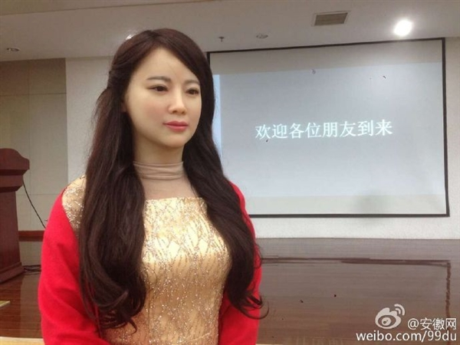
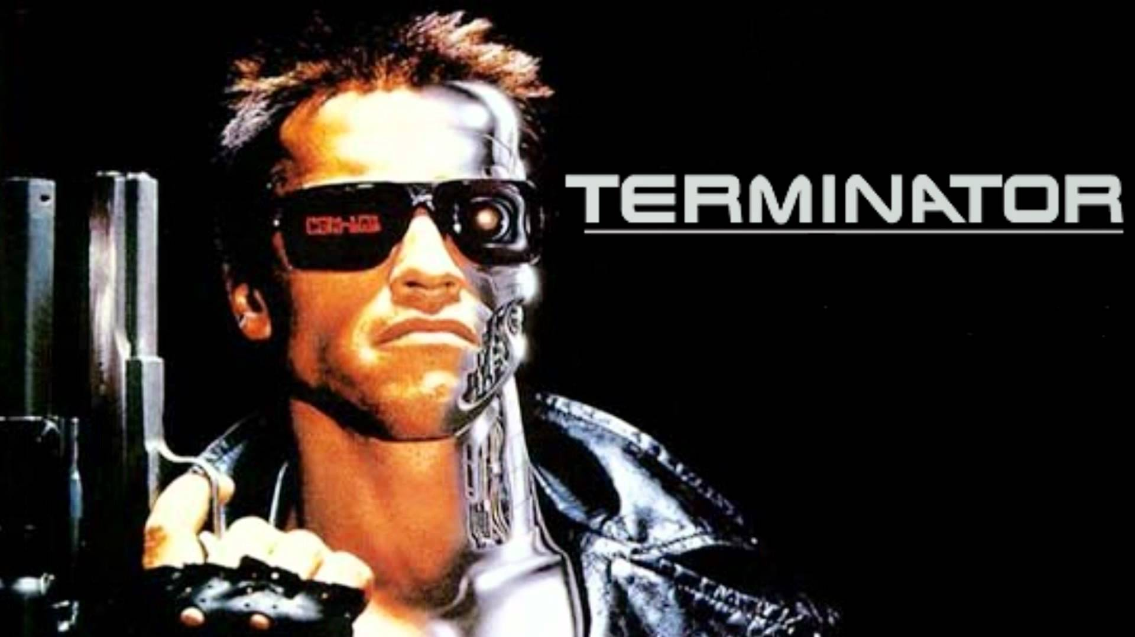
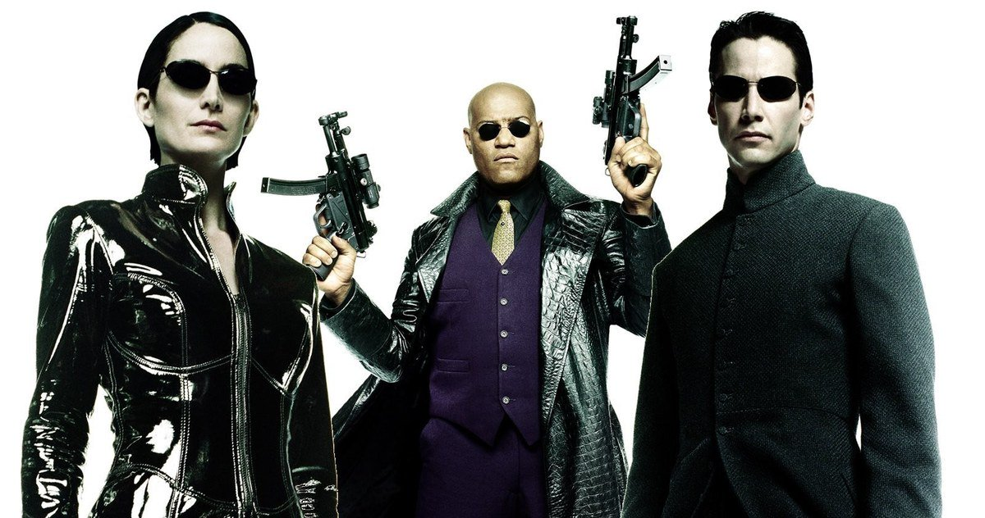
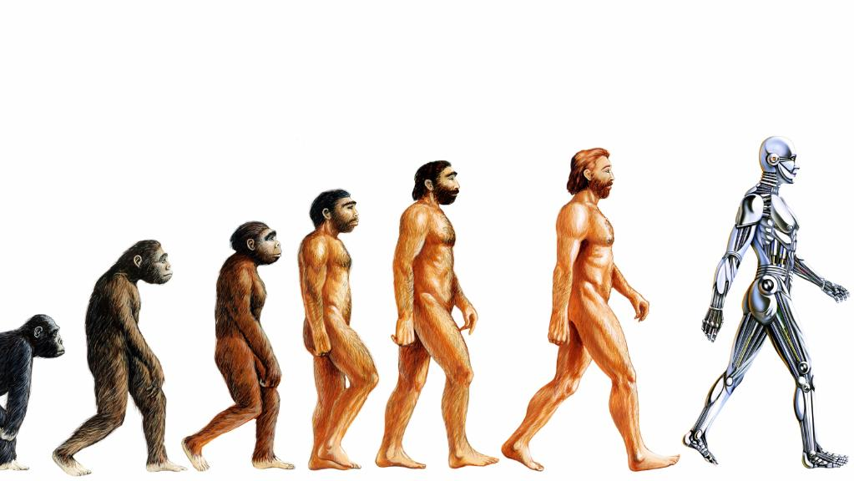
AI

Slide 3

Question 3
Conclusion
Question 1
Question 2

Slide 4
Question 1:
How widely and deeply has AI been applied in financial field?
Finance
Multiple dimensions
Organizations

Slide 5
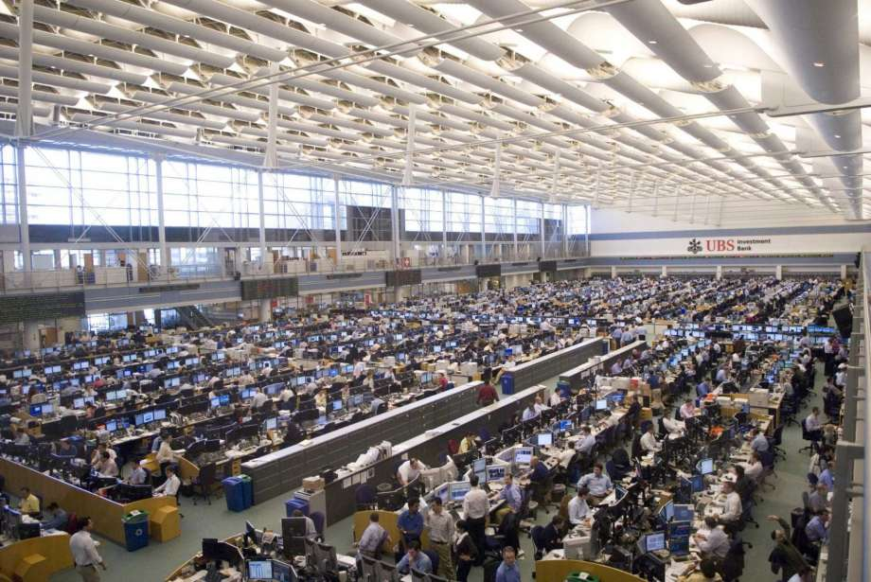
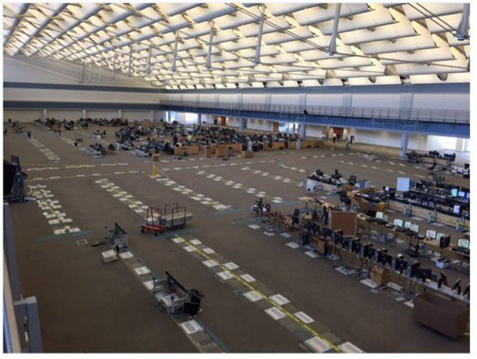
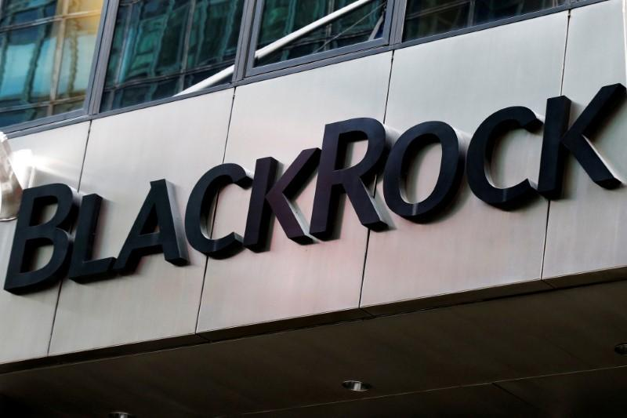
AI has been applied in multiple dimensions of the financial industry
Stock Trading
Wealth management

Slide 6

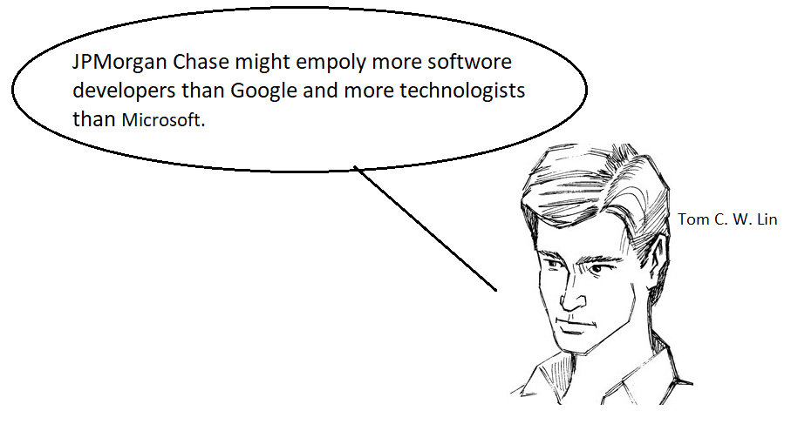
AI has changed the organization of the modern finance companies.
Organizations

Slide 7
Question 2: Why AI is a better choice than human workers for financial company?
AI is better
faster
More accurate
More impartial
Cheaper

Slide 8

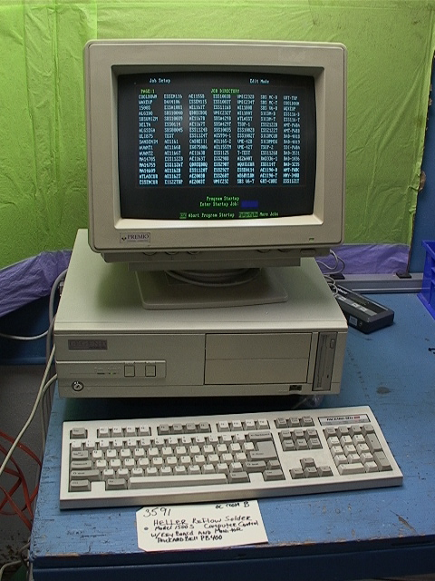
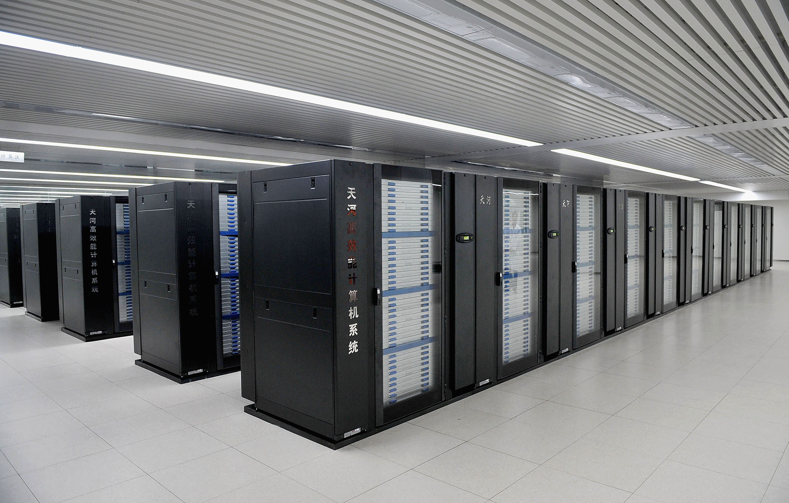
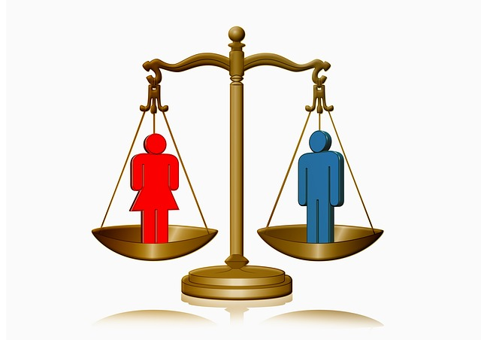
faster
Life time work
One hour
More accurate
More impartial

Slide 9

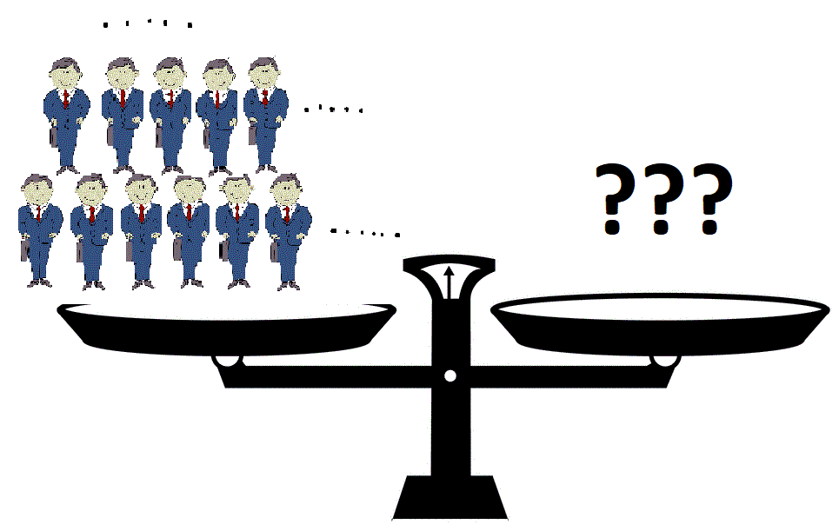
Reduce cost
General Worker
Average compensation
$500,000/year

Slide 10
Question 3: What kind of jobs would probably be taken over by AI?
Easy jobs
AI
Some senior-level jobs
Routine jobs

Slide 11
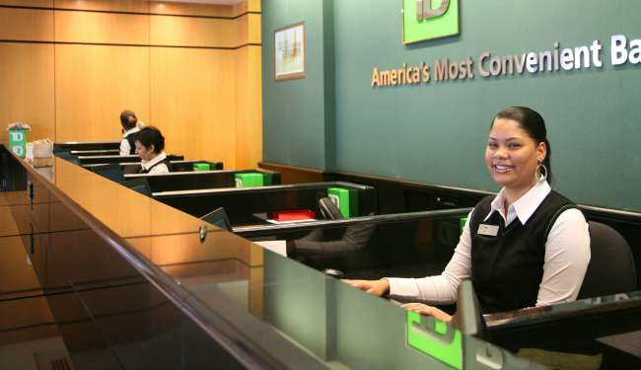



Bank teller
Easy or routine Jobs
Financial advisor
Some senior-level jobs
Creative jobs

Slide 12
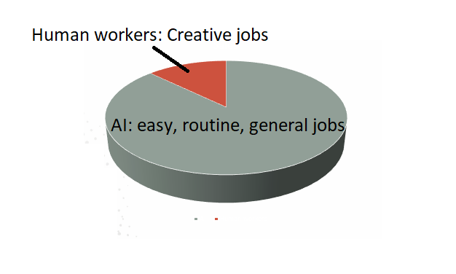
Conclusion

Slide 13
If this bad thing happen
future
?
Human workers

Slide 14
Thank You!
Free Powerpoint Templates
Visit to: www.freepptbackgrounds.net
Select
Categories & Colors & Popular Templates
Select your liked template designs
Download free and use it your presentation.
And Share our website.

Slide 15
Thank You!
Free Powerpoint Templates
Visit to: www.freepptbackgrounds.net
Select
Categories & Colors & Popular Templates
Select your liked template designs
Download free and use it your presentation.
And Share our website.

Slide 16
Thank You!
Free Powerpoint Templates
Visit to: www.freepptbackgrounds.net
Select
Categories & Colors & Popular Templates
Select your liked template designs
Download free and use it your presentation.
And Share our website.

